Slide 1
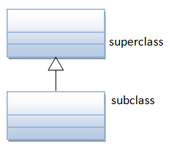
Java Programming
Inheritance & Polymorphism
继承与多态

Slide 2

Problem
How to sort student by different attribute?
By weight?
By height?
By name?

Slide 3
public class OOBMI {
public static void sortByWeight(Student[] items) {
Student tmp;
for (int i = items.length - 1; i > 0; i--) {
for (int j = 0; j < i; j++) {
if (items[j].weight>items[j + 1].weight) {
tmp = items[j];
students[j] = items[j + 1];
students[j + 1] =tmp;
}
}
}
}
}

Slide 4
public class OOBMI {
public static void sortByHeight (Student[] items) {
Student tmp;
for (int i = items.length - 1; i > 0; i--) {
for (int j = 0; j < i; j++) {
if (items[j].height>items[j + 1].height) {
tmp = items[j];
students[j] = items[j + 1];
students[j + 1] =tmp;
}
}
}
}
}

Slide 5
public class OOBMI {
public static void sortByName (Student[] items) {
Student tmp;
for (int i = items.length - 1; i > 0; i--) {
for (int j = 0; j < i; j++) {
if (items[j].name.compareTo(items[j + 1].name)>0) {
tmp = items[j];
students[j] = items[j + 1];
students[j + 1] =tmp;
}
}
}
}
}

Slide 6
Is it a good solution?
There are so many duplicated Code(重复代码)!
Problems associated with duplicate code
Inappropriate code duplication generally makes editing more difficult due to unnecessary increases in complexity and length.
This may lead to increased maintenance costs, more human error, forgotten or overlooked pieces of code, greater file size and may be indicative of a sloppy design.
https://en.wikipedia.org/wiki/Duplicate_code

Slide 7
Outline
Code Reuse(代码复用)
Inheritance(继承)
More on constructor & keyword “super”
Method Overriding & Variable Hiding
Annotation @Override
Polymorphism (多态)
Liskov Substitution Principle(Liskov替换原则)
Upcasting & Downcasting(上转与下转)
The "instanceof" Operator
Interface and abstract class
Example: sort student objects by different attributes

Slide 8

Code Reuse(代码复用)
Code reuse, also called software reuse, is the use of existing software, or software knowledge, to build new software, following the reusability principles.
Some characteristics that make software more easily reusable are modularity, loose coupling, high cohesion, information hiding and separation of concerns.

Slide 9
Code Reuse
There are three ways to reuse existing classes, namely, composition, inheritance and generic programming.
With composition (aka aggregation), you define a new class, which is composed of existing classes.
With inheritance, you derive a new class based on an existing class, with modifications or extensions.
With generic programming, algorithms are written in terms of types to-be-specified-later that are then instantiated when needed for specific types provided as parameters (we will talk about it in future).

Slide 10

Criticism
Code reuse results in dependency on the components being reused.
Rob Pike opined that "A little copying is better than a little dependency".
When he joined Google, the company was putting heavy emphasis on code reuse. He believes that Google's codebase still suffers from results of that former policy in terms of compilation speed and maintainability.

Slide 11
Class Inheritance(继承)
Class inheritance means that a subclass(子类) has a superclass or parent class (父类) from which it inherits operations and internal structure.
A subclass can add to the operations it inherits or can redefine inherited operations. However, classes cannot delete inherited operations.
It is a mechanism for code reuse and to allow independent extensions of the original software via public classes and interfaces.

Slide 12
Class Inheritance
Java supports only single inheritance. That is, a subclass can be derived from one and only one superclass.

Slide 13
common-root class(公共根类)
Java adopts a so-called common-root approach. All Java classes are derived from a common root class called java.lang.Object.
This Object class defines and implements the common behaviors (e.g. the toString method) that are required of all the Java objects running under the JRE.
These common behaviors enable the implementation of features such as multi-threading and garbage collector.

Slide 14
Methods of java.lang.Object
toString() - Returns a string representation of the object.
equals() - Indicates whether some other object is "equal to" this one.
hashCode() - Returns a hash code value for the object.
getClass() - Returns the runtime class of an object.
clone() - Creates and returns a copy of this object.
finalize() - Called by the garbage collector on an object when garbage collection determines that there are no more references to the object.
…

Slide 15
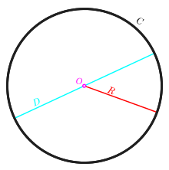
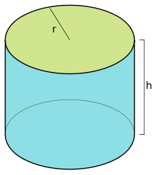
Inheritance Example
public class Circle {
…
}
public class Cylinder extends Circle {
…
}

Slide 16
More on Constructors
Subclass inherits all the variables and methods from its superclass.
Nonetheless, the subclass does not inherit the constructors of its superclass. Each class defines its own constructors.

Slide 17
More on Constructors
In the body of a constructor, you can use super(args) to invoke a constructor of its immediate superclass.
Note that super(args), if it is used, must be the first statement in the subclass' constructor. If it is not used in the constructor, Java compiler automatically insert a super() statement to invoke the no-arg constructor of its immediate superclass.

Slide 18
public class Circle {
// private instance variables
private double radius;
private String color;
// Constructors
public Circle() {
this.radius = 1.0;
this.color = "red";
}
// Describle itself
public String toString() {
return "Circle[radius=" + radius + ",color=" + color + "]";
}
// Return the area of this Circle
public double getArea() {
return radius * radius * Math.PI;
}
…
}

Slide 19
public class Cylinder extends Circle {
// private instance variable
private double height;
// Constructors
public Cylinder() {
super(); // invoke superclass' constructor Circle()
this.height = 1.0;
}
public Cylinder(double height) {
super(); // invoke superclass' constructor Circle()
this.height = height;
}
…
}

Slide 20
Keyword "super"
Inside a class definition, you can use the keyword “this” to refer to this instance.
Similarly, the keyword “super” refers to the superclass, which could be the immediate parent or its ancestor.
The keyword super allows the subclass to access superclass' methods and variables within the subclass' definition.

Slide 21
Method Overriding & Variable Hiding
A subclass inherits all the member variables and methods from its super classes (the immediate parent and all its ancestors).
It can use the inherited methods and variables as they are. It may also override(重写) an inherited method by providing its own version, or hide an inherited variable by defining a variable of the same name.

Slide 22
public class Cylinder extends Circle {
......
// Override the getArea() method inherited from superclass
@Override
public double getArea() {
return 2*Math.PI*getRadius()*height + 2*super.getArea();
}
// new method for Cylinder
public double getVolume() {
return super.getArea()*height; // use superclass' getArea()
}
// Override the inherited toString()
@Override
public String toString() {
return "Cylinder[" + super.toString() + ",height=" + height + "]";
}
}

Slide 23
Annotation @Override
The "@Override" is known as annotation (introduced in JDK 1.5), which asks compiler to check whether there is such a method in the superclass to be overridden.
This helps greatly if you misspell the name of the method to be overridden.
For example,
suppose that you wish to override method toString() in a subclass.
If @Override is not used and toString() is misspelled as TOString(), it will be treated as a new method in the subclass, instead of overriding the superclass.
If @Override is used, the compiler will signal an error.

Slide 24
The final modifier
You can declare a class, a variable or a method to be final.
A final variable cannot be re-assigned a new value.
A final method cannot be overridden in the subclass.
A final class cannot be sub-classed (or extended)

Slide 25
Method Overriding
The following methods of java.lang.Object always should be overrided
toString(), equals(), hashCode(), etc.

Slide 26
The toString method
Every object type has a method called toString that returns a string representation of the object.
When you display an object using print or println, Java invokes the object’s toString method automatically.
By default it simply displays the type of the object and its address, but you can override this behavior by providing your own toString method.

Slide 27
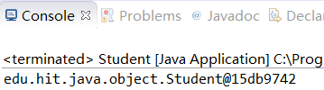
The toString method
System.out.println(new Student(“1160611003”);

Slide 28
Override the toString method
class Student{
@Override
public String toString(){
return String.format(“ %s \t%s \t%s \t%03.2fm \t%04.1fkg”,
this.SCHOOL, this.id, this.name, this.height, this.weight);
}
…
}

Slide 29
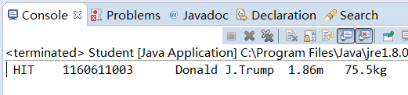
The toString method
public static void main(String[] args) {
Student s = new (“1160611004”,”Donald Trump”,1.86,75.5);
s.setName("Donald J.Trump");
s.setHeight(1.86);
s.setWeight(75.5);
System.out.println(s);
}

Slide 30
The equals method
The == operator checks whether objects are identical; that is, whether they are the same object.
The equals method checks whether they are equivalent; that is, whether they have the same value.

Slide 31


The equals method
Determine whether two students are the same person
public boolean equals(Student that) {
return this.id == that.id;
}
public boolean equals(Student that) {
return this.id.equals(that.id);
}

Slide 32
Polymorphism(多态)
Polymorphism is the provision of a single interface to entities of different types.
Types of polymorphism
Inheritance (simply polymorphism)
function overloading (Ad hoc polymorphism)
Generic programming (Parametric polymorphism)
Notes:
https://en.wikipedia.org/wiki/Polymorphism_(computer_science)

Slide 33

Liskov substitution principle
LSP (Liskov替换原则)
An object of type T may be substituted with any object of a subtype S
Because they share the same “interface”, just like you can substitute different brand tyres for your car.
https://en.wikipedia.org/wiki/Barbara_Liskov
Notes:
MIT教授，计算机科学家，美国首批计算机科学女博士，她因程序设计语言及面向软件设计方法方面的贡献，获得2008年度ACM图灵奖
她发明过两种编程语言, 她与周以真共同提出LSP
1. Liskov received the 2008 Turing Award from the ACM, in March 2009, for her work in the design of programming languages and software methodology that led to the development of object-oriented programming
2. Barbara Liskov and Jeannette Wing formulated the principle succinctly in a 1994 paper
3. In 1968 she became one of the first women in the United States to be awarded a Ph.D from a computer science department when she was awarded her degree from Stanford University

Slide 34
Substitutability
In Java, a subclass possesses all the attributes and operations of its superclass.
This means that a subclass object can do whatever its superclass can do.
As a result, we can substitute a subclass instance when a superclass instance is expected, and everything shall work fine. This is called substitutability.
Notes:
子类可以替换父类

Slide 35
Upcasting & Downcasting
Substituting a subclass instance for its superclass is called upcasting(上转).
Upcasting is always safe because a subclass instance possesses all the properties of its superclass and can do whatever its superclass can do.
Substituting a superclass instance for its subclass is called downcasting(下转).
Downcasting is not always safe, and throws a runtime ClassCastException if the instance to be downcasted does not belong to the correct subclass.

Slide 36
Upcasting & Downcasting
// upcast is safe
Circle c1 = new Cylinder(5.0);
// downcast needs the casting operator
Cylinder cy1 = (Cylinder) c1;

Slide 37
The "instanceof" Operator
Java provides a binary operator called instanceof which returns true if an object is an instance of a particular class.
Circle c1 = new Circle();
Cylinder cy1 = new Cylinder(5.0);
System.out.println(c1 instanceof Circle); // true
System.out.println(c1 instanceof Cylinder); // false
System.out.println(cy1 instanceof Cylinder); // true
System.out.println(cy1 instanceof Circle); // true

Slide 38
Abstract method
An abstract method is a method with only signature (i.e., the method name, the list of arguments and the return type) without implementation (i.e., the method’s body).
You use the keyword abstract to declare an abstract method.

Slide 39
Abstract class(抽象类)
A class containing one or more abstract methods is called an abstract class.
an abstract class provides a template for further development. The purpose of an abstract class is to provide a common interface to all its subclasses.
An abstract class is incomplete in its definition, since the implementation of its abstract methods is missing. Therefore, an abstract class cannot be instantiated.

Slide 40
Abstract class
To use an abstract class, you have to derive a subclass from the abstract class.
In the derived subclass, you have to override the abstract methods and provide implementation to all the abstract methods.

Slide 41
Interface(接口)
A Java interface is a 100% abstract superclass which define a set of methods its subclasses must support.
An interface contains only public abstract methods (methods with signature and no implementation) and possibly constants (public static final variables).

Slide 42
Interface
Unlike a normal class, where you use the keyword "extends" to derive a subclass. For interface, we use the keyword "implements" to derive a subclass.
A subclass can implement more than one interfaces.

Slide 43
Interface Naming Convention
Use an adjective (typically ends with "able") consisting of one or more words. Each word shall be initial capitalized (camel-case).
For example,
Serializable,
Extenalizable,
Movable,
Clonable,
Runnable, etc.

Slide 44
Abstract class vs interface
Abstract class can contain partial implementation (such as instance variables and methods).
Interface cannot contain any implementation, but merely defines the behaviors.

Slide 45
Interface Example
public interface MyRunnable {
…
}
public class RunnableTask implements MyRunnable{
…
}

Slide 46
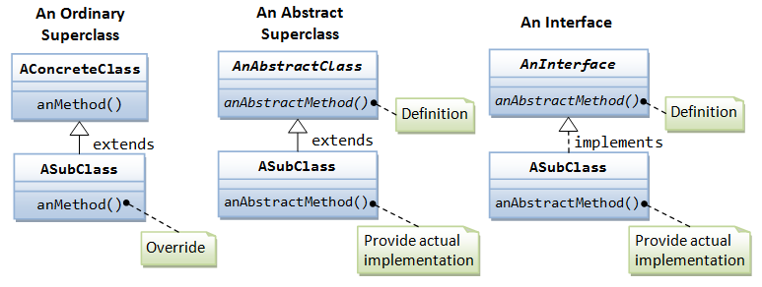
UML notations
Notes:
The UML notation uses a solid-line arrow linking the subclass to a concrete or abstract superclass, and dashed-line arrow to an interface as illustrated. Abstract class and abstract method are shown in italics.

Slide 47
Solving the problem
sort student objects by different attributes
By weight
By height
By name
By …

Slide 48
public class ArraySort {
public static void bubbleSort(Student[] items, Compare cm) {
Student tmp;
for (int i = items.length - 1; i > 0; i--) {
for (int j = 0; j < i; j++) {
if (cm.compare(items[j], items[j + 1])) {
tmp = items[j];
items[j] = items[j + 1];
items[j + 1] = tmp;
}
}
}
}
}
How can we make this class more reusable?

Slide 49
public class ArraySort {
public static void bubbleSort(Object[] items, Compare cm) {
Object tmp;
for (int i = items.length - 1; i > 0; i--) {
for (int j = 0; j < i; j++) {
if (cm.compare(items[j], items[j + 1])) {
tmp = items[j];
items[j] = items[j + 1];
items[j + 1] = items[0].getClass().cast(tmp);
}
}
}
}
}

Slide 50
public abstract class Compare {
protected boolean orderAsc=true;
protected boolean result=true;
public Compare(){
this.orderAsc=true;
}
public Compare(boolean order){
this.orderAsc=order;
}
public boolean compareResult() {
if (this.orderAsc) return this.result;
else return !this.result;
}
public abstract boolean compare(Object st1, Object st2);
}

Slide 51
private class CompareHeight extends Compare {
public CompareHeight(boolean order) {
super(order);
}
public boolean compare(Object o1, Object o2) {
Student st1 = (Student) o1;
Student st2 = (Student) o2;
super.result=(st1.getHeight() > st2.getHeight());
return compareResult();
}
}

Slide 52
private class CompareName extends Compare {
public CompareName(boolean order) {
super(order);
}
public boolean compare(Object o1, Object o2) {
Student st1 = (Student) o1;
Student st2 = (Student) o2;
super.result=
( st1.getName().compareTo(st2.getName())>0);
return compareResult();
}
}

Slide 53
public class BMI {
private Student[] students;
public static void main(String[] args) {
BMI bmi = new BMI(); // initialing the students
Compare cm = new CompareHeight(true);
//cm = new CompareName(false);
ArraySort.bubbleSort(bmi.students, cm);
bmi.showStudents();
}
public BMI(){…}
private class CompareHeight extends Compare {…}
private class CompareName extends Compare {…}
private void showStudents() {
for (Student st : students)
System.out.println(st);
}
}

Slide 54
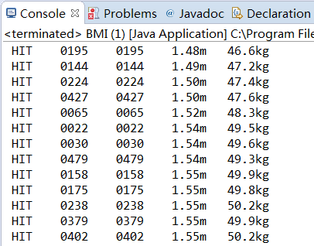
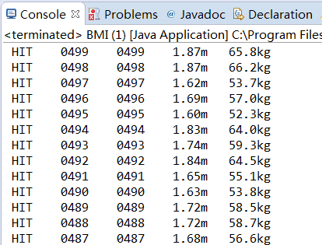
Demo

Slide 55
Summary
Object-oriented programming (OOP)
is a programming paradigm based on the concept of "objects", which may contain data, in the form of fields, often known as attributes; and code, in the form of procedures, often known as methods.
The three important features OOP:
Encapsulation
Inheritance
Polymorphism

Slide 56


